Slide 1




NEXT GEN EMPLOYABILITY PROGRAM
Creating a future-ready workforce
Team Members
College Name
Student Name : kalaiyarasi G
Student ID : au513521243010
5135-Annai Mira College of engineering and technology,
Ranipet

Slide 2

CAPSTONE PROJECT SHOWCASE
Project Title
Building Bus Reservation System using Python and Django
Abstract | Problem Statement | Project Overview | Proposed Solution | Technology Used | Modelling & Results | Conclusion

Slide 3
Abstract
Introduction To The Topic Of Bus Ticket Booking Systems.
Importance And Relevance Of Efficient Bus Ticket Booking Systems In Modern Transportation.
The Bus Reservation System Project Aims To Streamline The Process Of Booking Bus Tickets By Providing An Efficient And User-friendly Platform For Passengers.
This System Automates Ticket Booking, Seat Selection, And Payment Processes, Enhancing The Overall Experience For Both Passengers And Bus Operators
Source :

Slide 4
Problem Statement
Traditional bus ticket booking systems often involve long queues, manual ticketing processes, and limited accessibility.
This leads to inconvenience for passengers and operational challenges for bus companies. Therefore, there is a need for a modernized and efficient bus reservation system to address these issues and improve the overall booking experience.
Challenges faced by bus operators in managing ticket inventory and customer data effectively.
Need for a streamlined and user-friendly ticket booking platform
Source :

Slide 5
Project Overview
The existing bus ticketing process is plagued by inefficiencies such as manual ticketing, limited seat availability visibility, and cumbersome payment procedures.
Passengers often face challenges in securing tickets, especially during peak travel seasons.
Additionally, bus operators struggle to manage bookings and optimize seat utilization efficiently.
These issues result in dissatisfied customers and lost revenue opportunities for bus companies.
Source :

Slide 6
Proposed Solution
.
The proposed bus reservation system will leverage technology to automate and streamline the ticket booking process.
It will feature a user-friendly interface for passengers to search for bus routes, select seats, and make secure payments online.
The system will provide real-time seat availability updates, allowing passengers to make informed decisions.
Furthermore, bus operators will benefit from backend management tools to efficiently handle bookings, manage schedules, and track revenue.
Integration with mobile apps and online payment gateways will enhance accessibility and convenience for users.
Source :

Slide 7


Technology Used
Front-end
Back-end
Source :

Slide 8
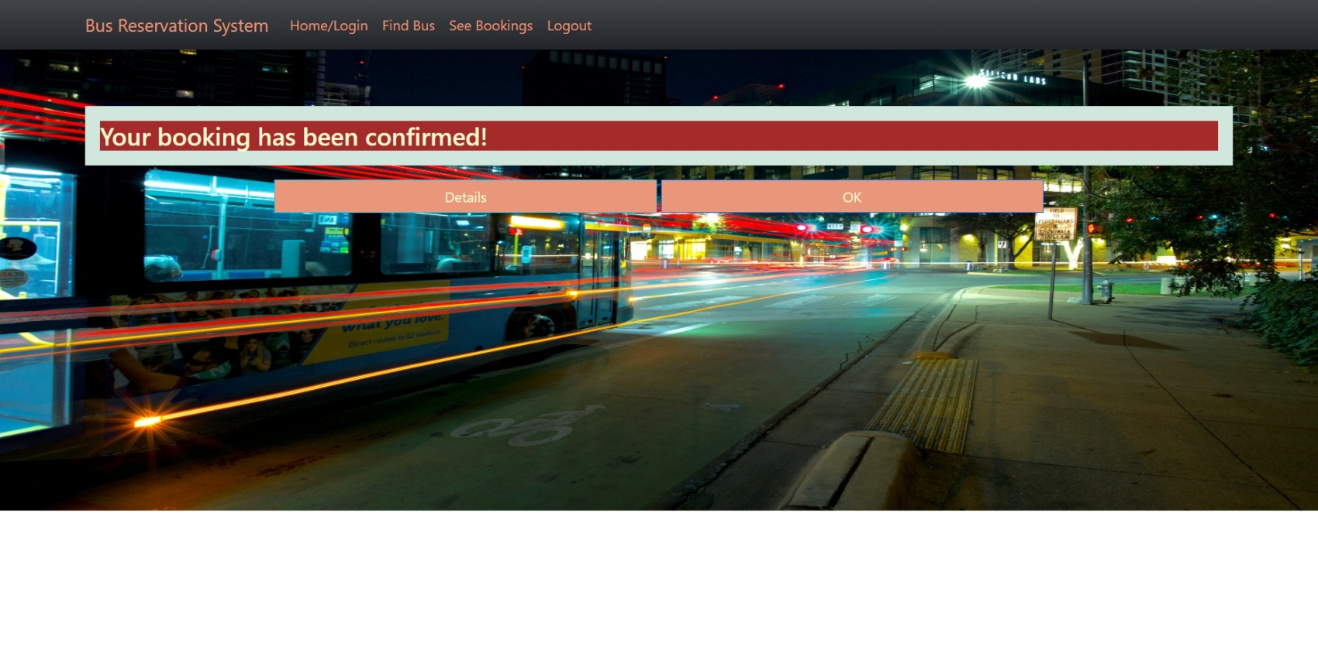
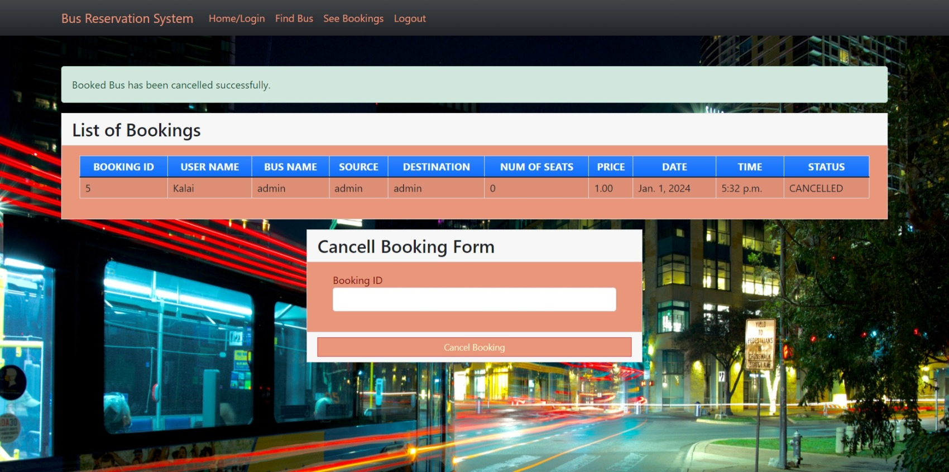
Modelling & Results
Source :

Slide 9
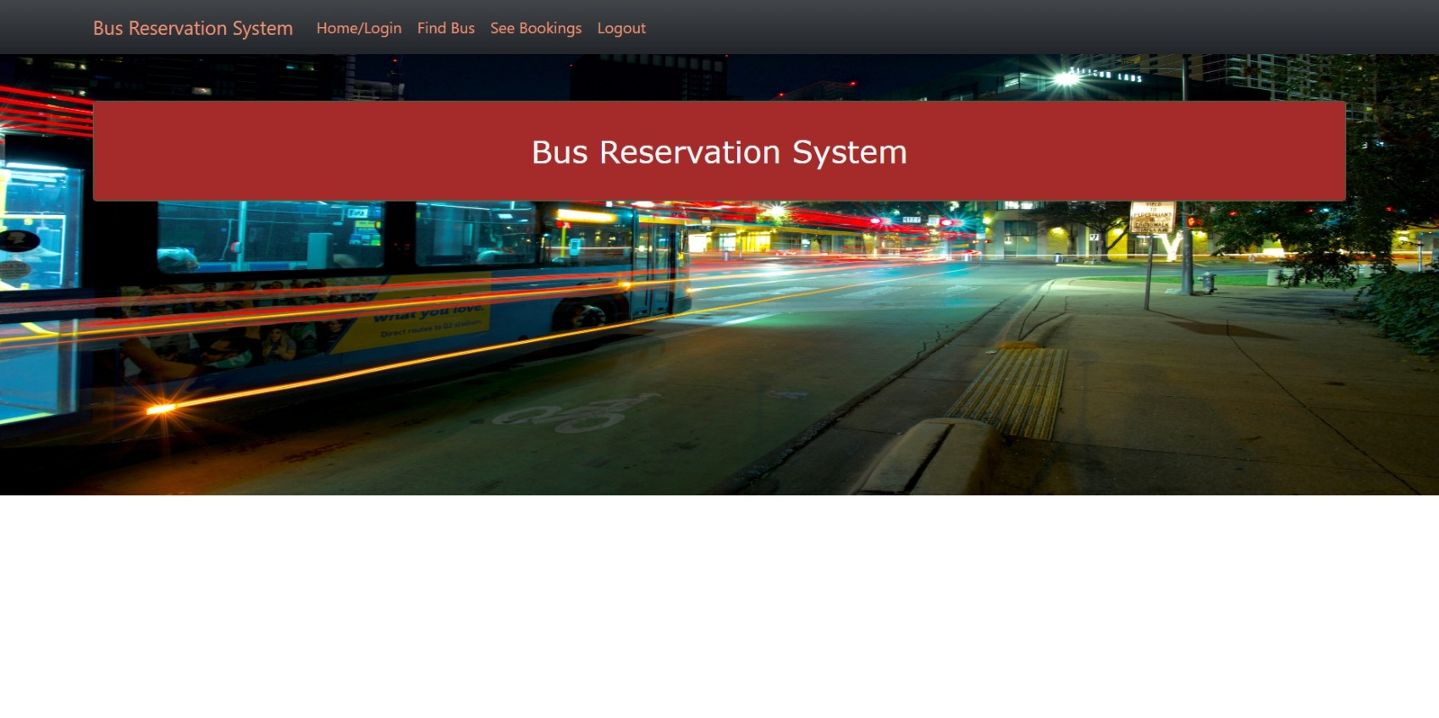
Homepage

Slide 10
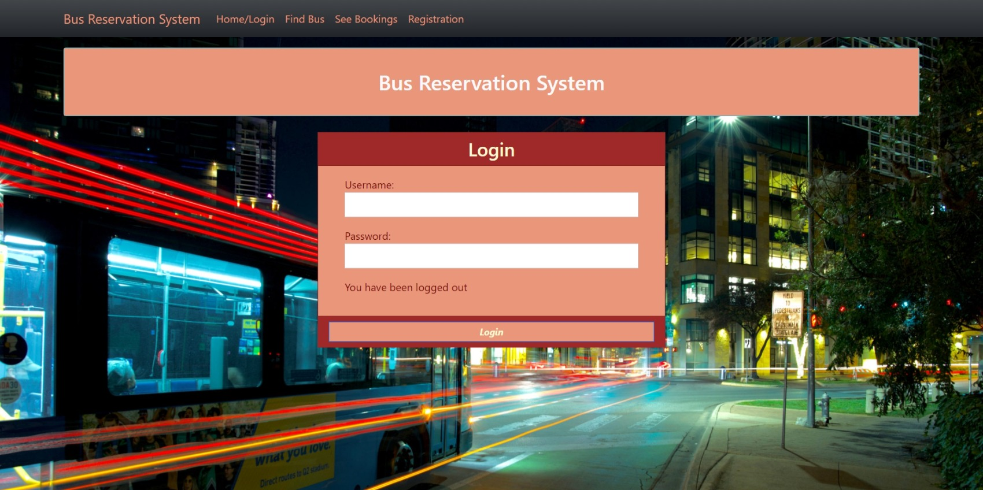
login

Slide 11
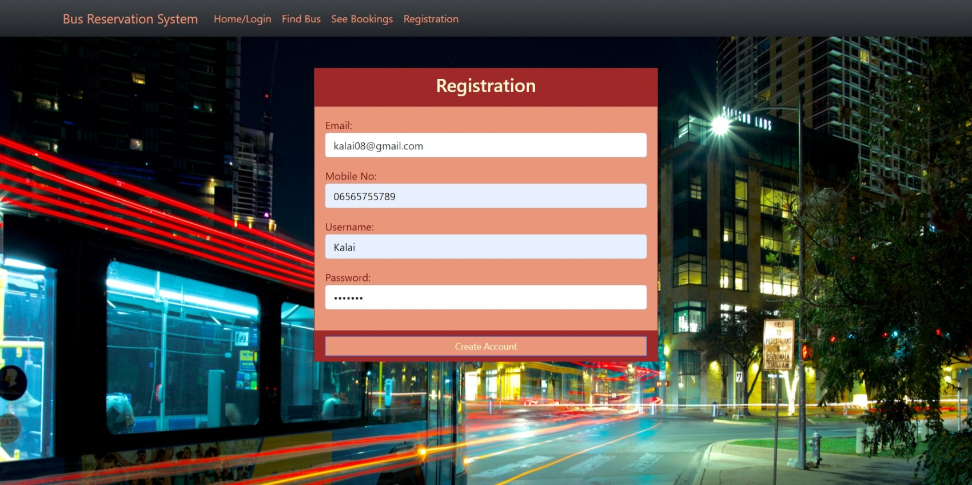
Registration

Slide 12
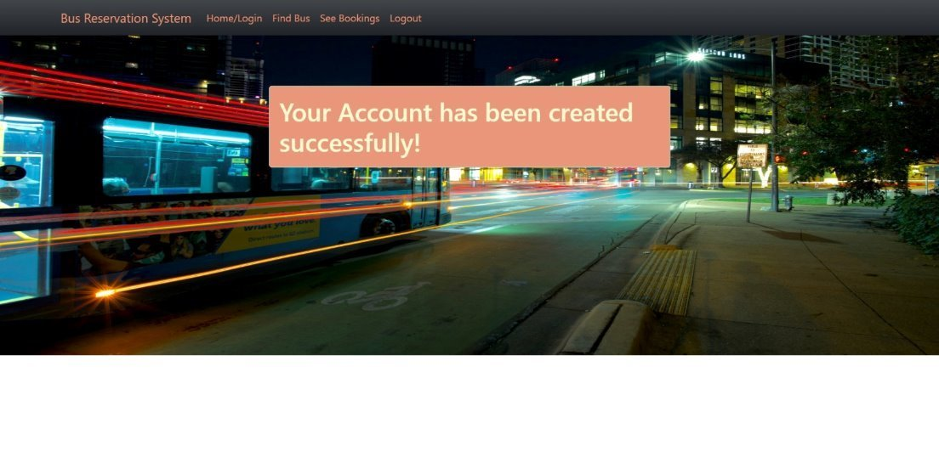
Account created

Slide 13
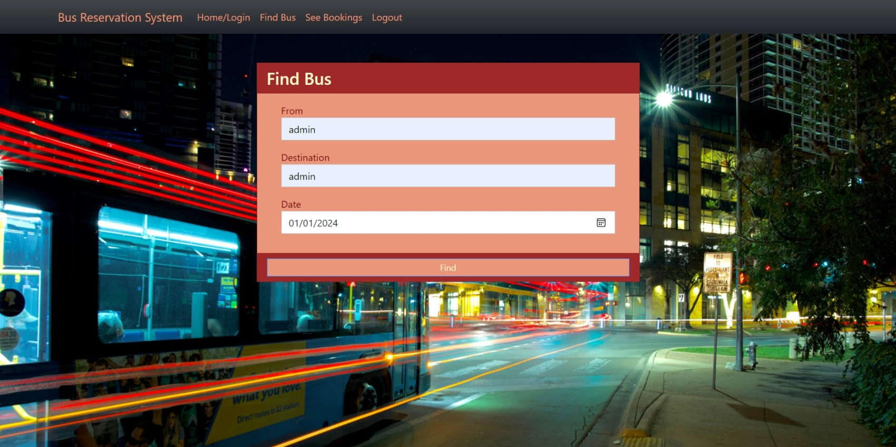
Find bus:

Slide 14
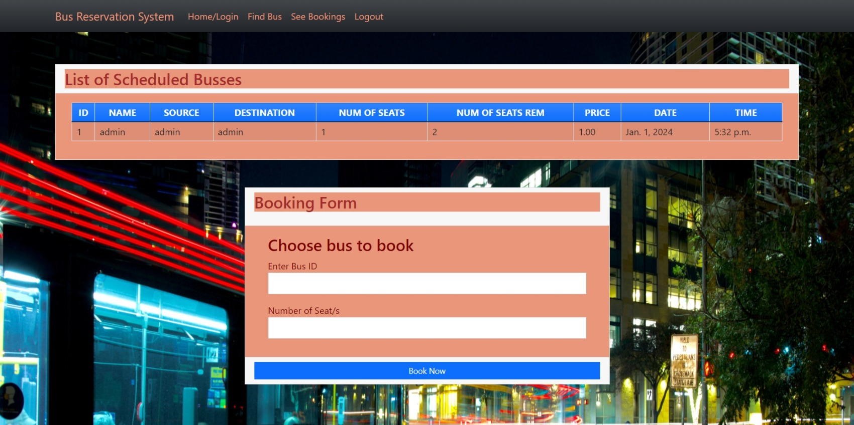
Choose bus:

Slide 15
Booking conformed:

Slide 16
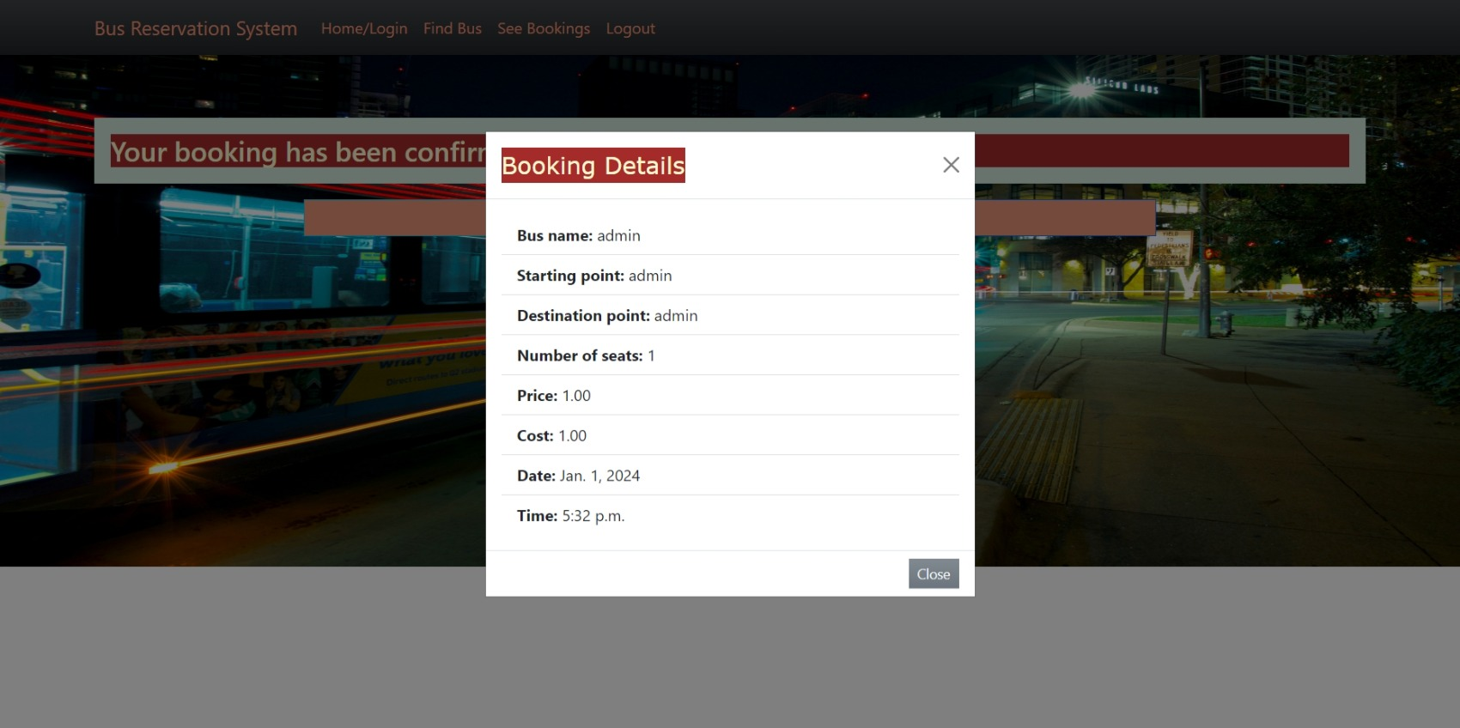
Booked bus details:

Slide 17
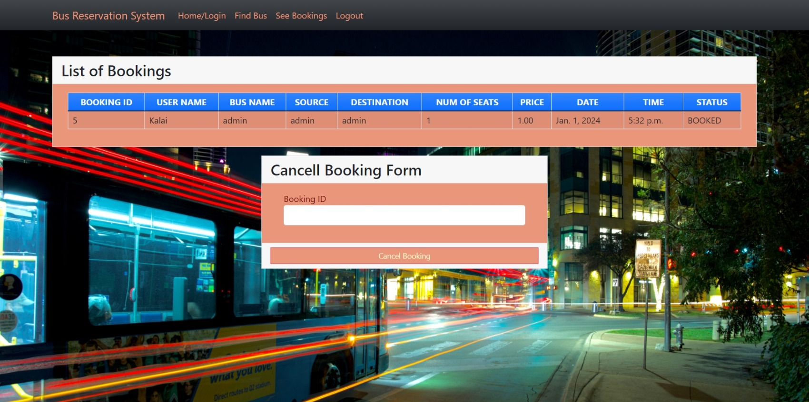
List of booking and cancel form:

Slide 18
Bus cancel confirm

Slide 19
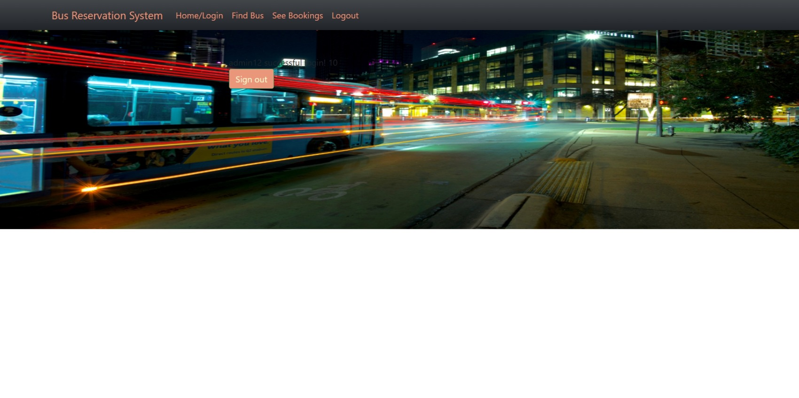
Sign out:

Slide 20
Future Enhancements:
Suggestions for potential future enhancements or additional features to further improve the booking platform.
Exploration of advanced technologies like artificial intelligence for personalized recommendations and predictive seat availability.
Consideration of expanding the platform to integrate with other modes of transportation for seamless multi-modal travel experiences

Slide 21
Conclusion
In conclusion, the bus reservation system project addresses the inefficiencies inherent in traditional bus ticketing processes by introducing a modernized and user-friendly platform.
By automating ticket booking, seat selection, and payment processes, the system improves the overall booking experience for passengers while providing operational benefits for bus operators.
With enhanced accessibility, real-time updates, and efficient backend management tools, the system aims to revolutionize the way bus tickets are booked and managed, ultimately benefiting both passengers and bus companies
Source :

Slide 22
Thank You!
Notes:
Thank You !!

